Slide 1

Team: Dragon fruit
Владислав Карамфилов
Ангел Стоянов
Светослав Манчев
Христo Малеев
Калин Николов

Slide 2
Organization
Skype
Meetings in the Academy

Slide 3
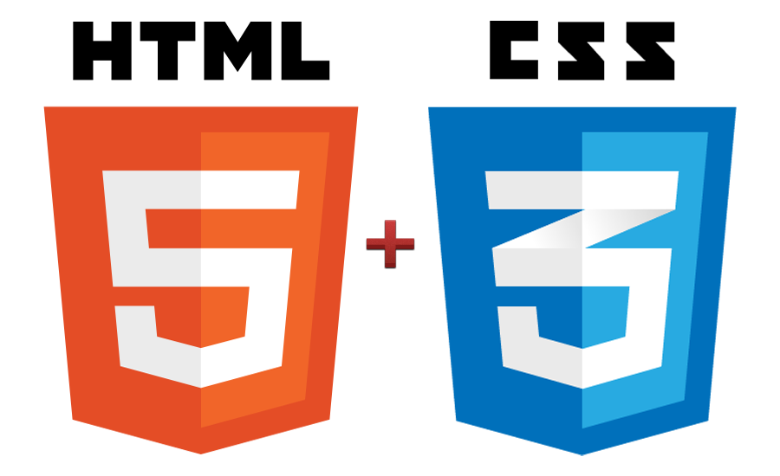



Technologies used
HTML5
CSS3
jQuery
jQuery.UI
QUnit
Standalone Prototype.js Class System
- by Seraf Dos Santos

Slide 4
Requirements covered
?? 4 namespaces
?? 10 Classes
QUnit testing
jQueryUI implemented
Used Local Storage – User/Result
Tweet top score
?? Browser support:
Google Chrome 26, Mozilla Firefox 21, IE9+, Opera 12
Best practices for OO design
SVN: http://tanks-game.googlecode.com/svn/trunk/

Slide 5
Demo

Slide 6


Questions

Slide 7
Thank you

